Slide 1


IMDb Movie Analysis
Prepared by : Shivam Singh
Email id: Shivamkumsingh@gmail.com

Slide 2

Contents
Project Description
Approach
Tech-Stack Used
Data Analytics Task & Insights
Result and Conclusion

Slide 3


Project Description
This project investigates an IMDb dataset with filtered movie metadata such as director names, genres, lengths, languages, budgets, revenues, and scores. It seeks to determine patterns and relationships between variables such as genre popularity, average length, score variance by language, director performance, and budget-to-gross profitability.
The data was cleaned and grouped to see trends and determine the reasons behind a movie's success.

Slide 4

Approach
Data Extraction: Downloaded and Imported the dataset into Excel.
Data Cleaning: Cleaned the data by removing missing, Duplicates or invalid entries.
Analysis: Used Pivot Tables and charts to visualize trends and uncover key insights and analyzed the findings and compiled them into a report.

Slide 5



Tech-Stack Used
Microsoft Excel: Applied in data cleaning and visualizations. It also possesses features like charts, graphs, and pivot tables to simplify data analysis and interpretation.
Microsoft PowerPoint (PPT): Used for organizing and presenting findings.
Google Drive: For storing and sharing reports.

Slide 6
Data Analytics Task
There was irrelevant data in Columns: ‘Color’, ‘director_facebook_likes’, ‘actor_3_facebook_likes, ‘actor_2_name’, ‘actor_1_facebook_likes’, ‘cast_total_facebook_likes, ‘actor_3_name’, ‘facenumber_in_posts’, ‘plot_keywords’, ‘movie_imdb_link’, ‘content_rating’ ,’actor_2_facebook_likes’, ‘aspect_ratio’, ‘movie_facebook_likes’ was removed.
Eliminate the rows from the dataset having anyone of its column value as Blank/NULL.
Removing off the duplicate values in the dataset which can be achieved by using the ‘Remove Duplicate Values/Cells’ available in the ‘Data’ tab.
The ‘genres’ column was splits into individuals ‘genre’ to used in the task.
Sheet named: ‘Cleaned’ was used for all analysis and insights.
All the Charts are attached to respective tasks.
Click here for the Dataset used

Slide 7
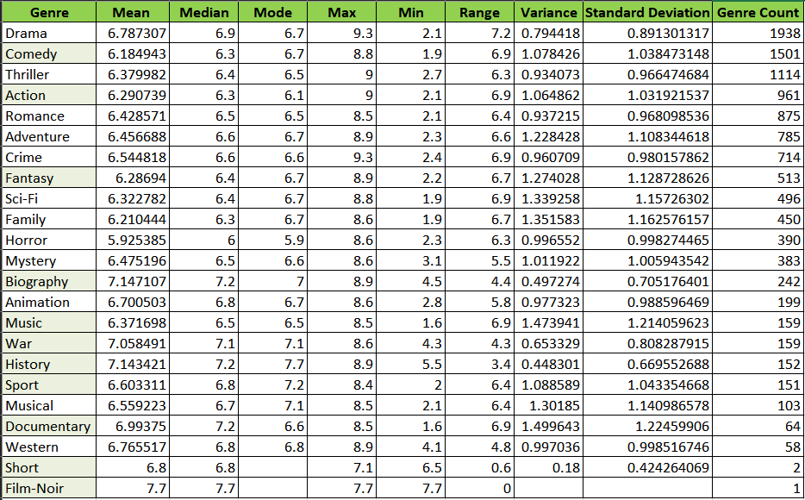
Insights
A. Movie Genre Analysis: Determine the most common genres of movies in the dataset. Then, for each genre, calculate descriptive statistics (mean, median, mode, range, variance, standard deviation) of the IMDB scores.

Slide 8
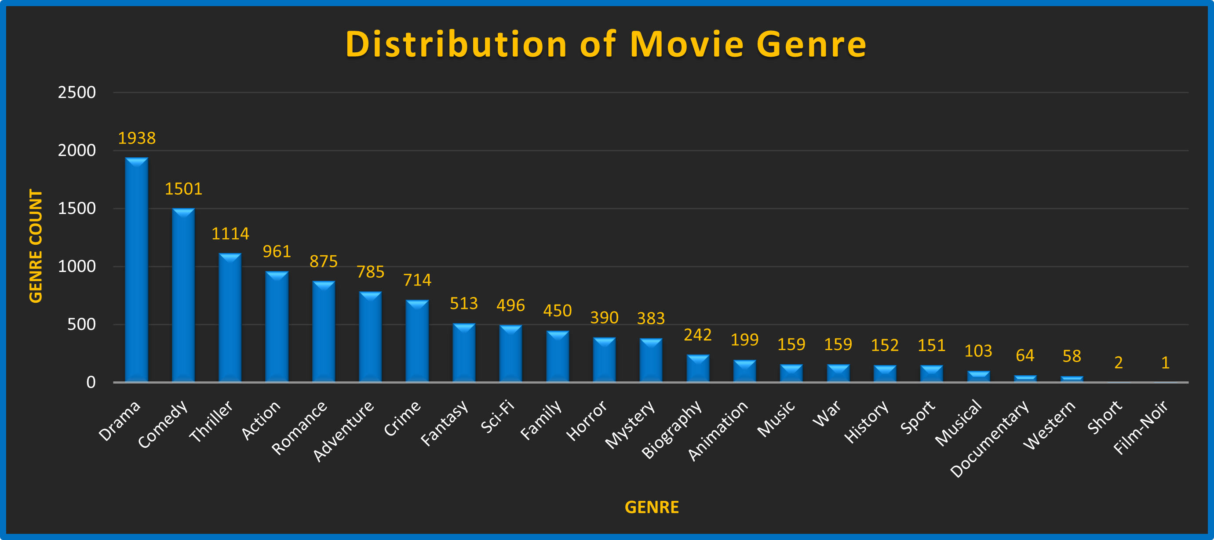
Average Ratings (Mean): Formula used: =AVERAGEIFS()
* Highest: Drama (6.79), Romance (6.43), and Thriller (6.38)
* Lowest: Comedy (6.18) and Action (6.29)
→ Dramas have a slightly higher average rating, and comedies fall behind by a fraction.
Consistency (Standard Deviation & Variance) :
* Most Consistent: Drama (SD: 0.89, Var: 0.79)
* Highest Variable: Comedy (SD: 1.04, Var: 1.08)
→ Drama has higher and steadier ratings, while Comedy has a greater range in how people react to it.

Slide 9

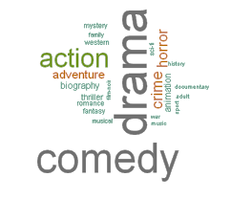
Max & Min Ratings: Formula used: =MAX(IF(Cleaned!O:O=A2, Cleaned!M:M)) and =MIN(IF(Cleaned!O:O=A2, Cleaned!M:M)) M:M is the imbd_score
* Widest Range: Comedy and Action (Range: 6.9)
* Narrowest Range: Thriller (Range: 6.3)
→ Thrillers are more tightly clustered around their mean rating, suggesting a narrower range of audience response.
Median & Mode:
* Median equals or just higher than Mean in all genres, which reflects a balanced but slightly deviate distribution.
* The mode is always the same (approximately 6.5-6.7) across different genres, which shows what people prefer.
Genre Count: Formula used: =COUNTIF(Cleaned!O:O, A2) O:O is the genre list from sheet – Cleaned.
* Most movies: Drama (1941)
* Fewest (according to visible data): Romance (877)
→ More individuals in Drama would render its statistics more reliable.

Slide 10
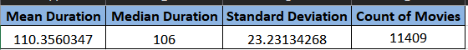
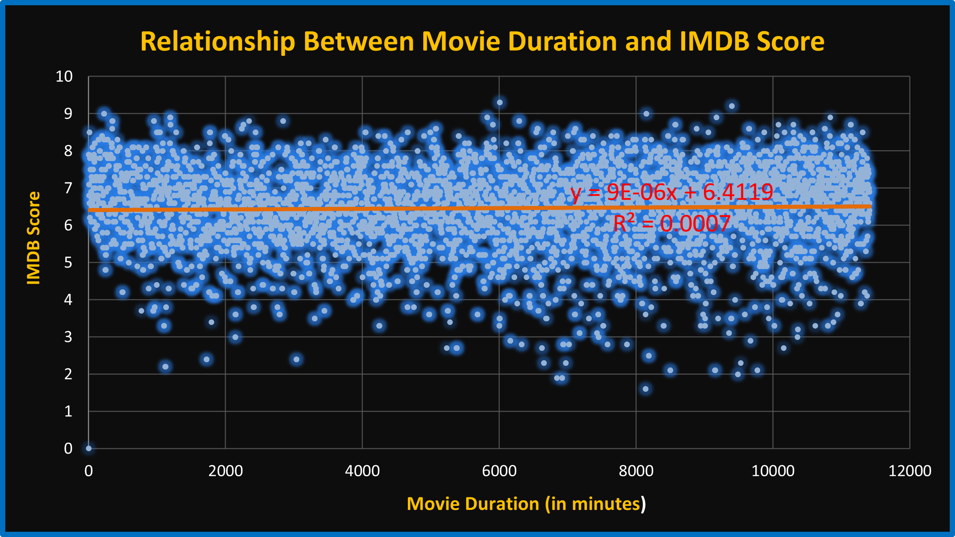
B. Movie Duration Analysis: Analyze the distribution of movie durations and identify the relationship between movie duration and IMDB score.
There is no significant linear relationship between a movie’s duration and its IMDB score.
The very low R² value indicates that duration does not meaningfully impact audience ratings.
Average Duration: Movies have an average duration of approximately 110 minutes.
Consistency: The standard deviation (~23 min) indicates a relatively consistent movie length distribution.

Slide 11
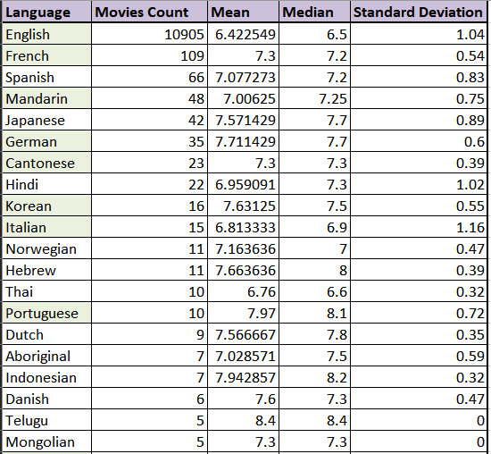
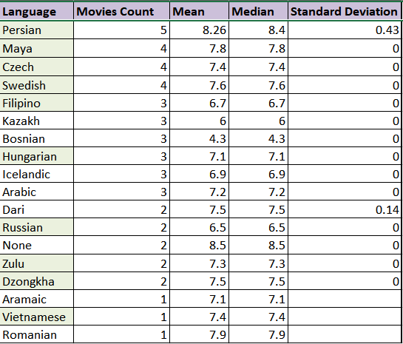
C. Language Analysis: Determine the most common languages used in movies and analyze their impact on the IMDB score using descriptive statistics.
English Dominates in Volume, But Not in Ratings:
Movies Count: 10,905
Mean Rating: 6.42 – the lowest among major languages
Standard Deviation: 1.04 – fairly high, indicating that while some movies are highly rated, many receive lower scores.

Slide 12
Top Rated Languages (High Mean ):
Language Mean Count Notes
Telugu 8.4 5 Highest mean, but very small count, May reflect niche or cult appeal.
Persian 8.26 5 Also very high, but low sample size.
Portuguese 7.97 10 High and more reliable than Telugu/Persian due to higher count.
Indonesian 7.94 7 Small sample, high score — niche influence likely.
Reflect niche, highly rated entries rather than general quality.
Low Rated Languages:
Language Mean Count Notes
English 6.42 10,905 Lowest mean overall.
Bosnian 4.3 3 Very low, but small count.
Kazakh 6 3 Low mean, small sample.
In small samples, extreme values can dominate.
Language with High Ratings and Good Sample Size:
Language Mean Count Std Dev Notes
Japanese 7.57 42 0.89 High quality perception, strong cinema culture.
German 7.71 35 0.6 High and consistent.
French 7.3 109 0.54 More reliable sample, consistently well-rated.
Spanish 7.08 66 0.82 Popular globally, diverse film industry.
These offer a balance between popularity and consistent quality.
Consistency (Low Standard Deviation):
Language Std Dev Mean Count
Hebrew 0.39 7.66 11
Cantonese 0.39 7.3 23
Indonesian 0.32 7.94 7
Thai 0.32 6.76 10
Demonstrate tight rating ranges, suggesting uniformly well-received films, even if fewer in number.

Slide 13
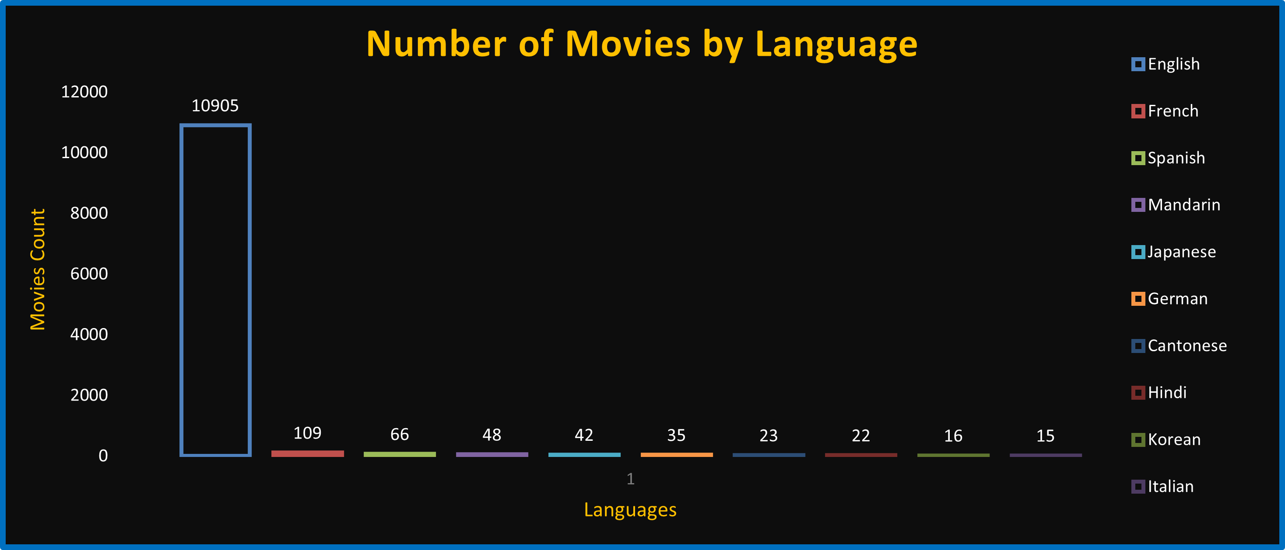

Although small sample sizes bias results higher or lower, languages like French, German, Japanese, and Spanish balance quality, consistency, and believability among audience ratings to become great performers in world cinema.

Slide 14
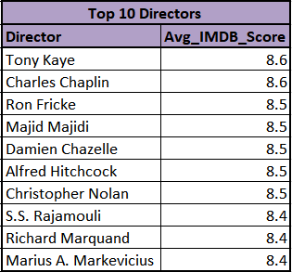
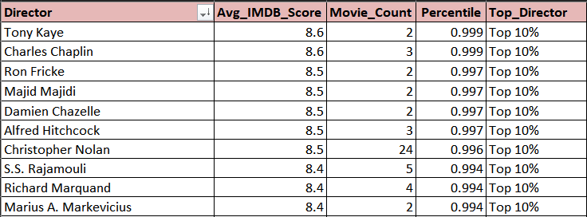
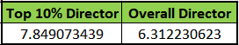
D. Director Analysis: Identify the top directors based on their average IMDB score and analyze their contribution to the success of movies using percentile calculations.
Director list , Avg_IMDB_Score and Movie_Count are calculated with Pivot Table, in which ‘director_name’ will be in Row section and ‘imdb_score’ ( Sheet – Cleaned ) in the value section twice, and change from field setting to Average and Count respectively.
For Percentile, formula used =PERCENTRANK.INC(B$2:B$1747, B2) where B2 will change for Avg_IMDB_Score, so drag the value till last row.
For Top_Director, formula used =IF(D2>=0.9, "Top 10%", "Others") where D2 will change for Percentile so drag till last row.
For Top 10% Director, formula used =AVERAGEIFS(B2:B1747, E2:E1747, "Top 10%") where B2:B1747 is the Avg_IMDB_Score and E2:E1747 is the Top_Director till last row.
For Overall Director, formula used =AVERAGE(B2:B1747) where B2:B1747 is the Avg_IMDB_Score till last row.

Slide 15
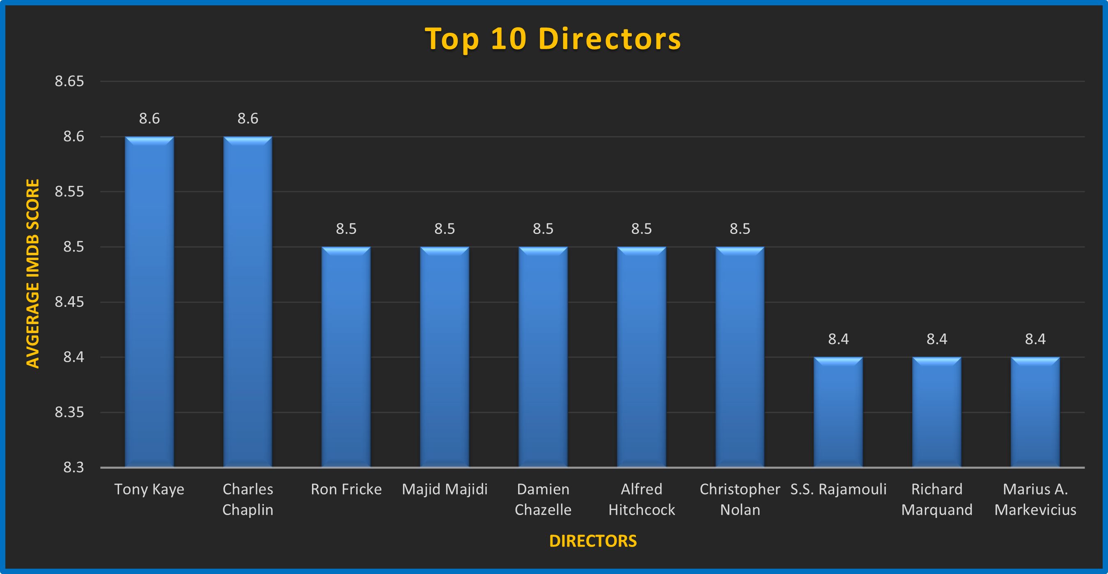
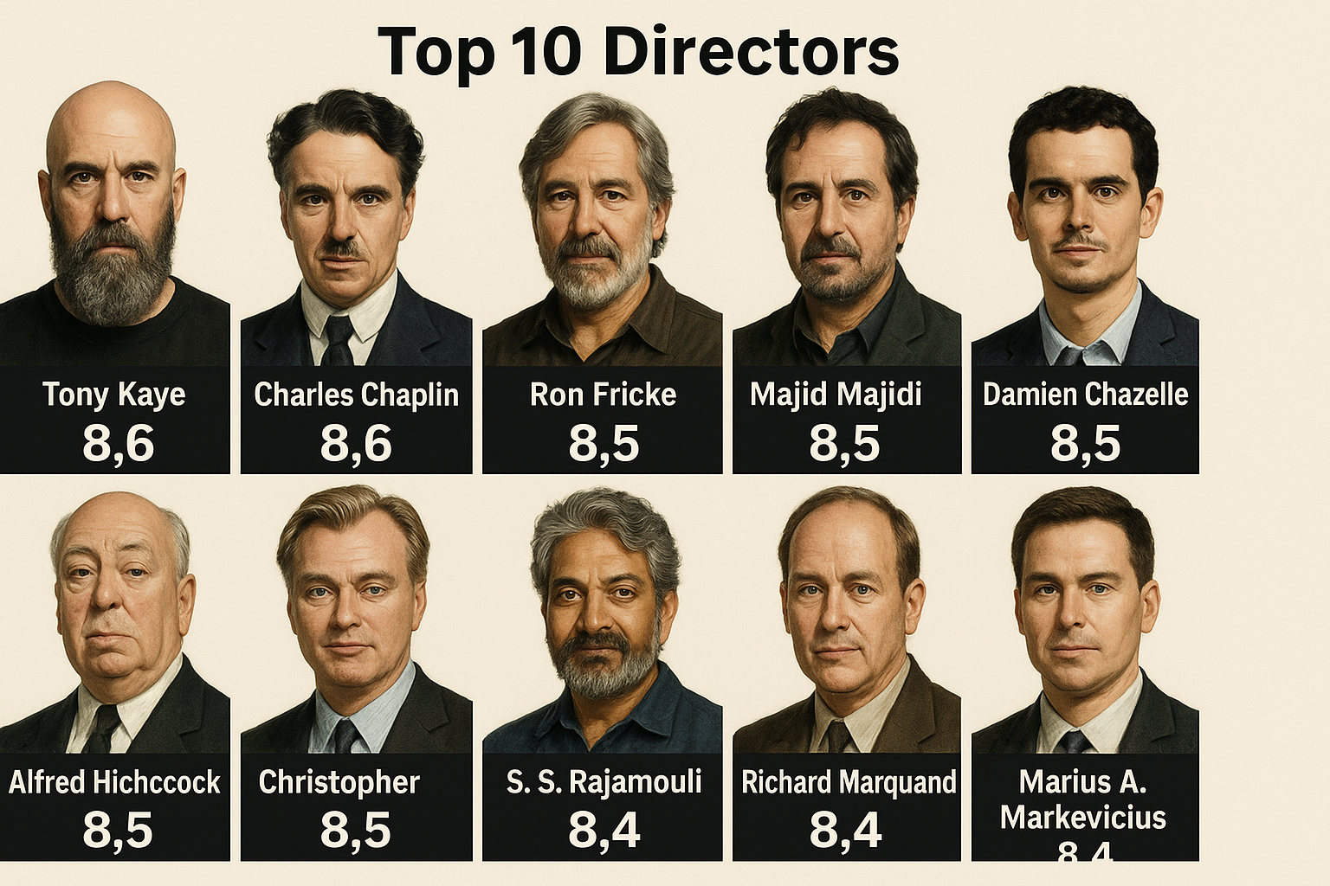
High mean scores suggest that percentile ranking is a good way to determine high-scoring filmmakers.
These directors are likely to have a mix of good ratings, regular quality, and possibly dedicated fans that help to improve their ratings.

Slide 16
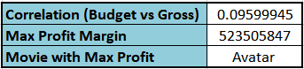
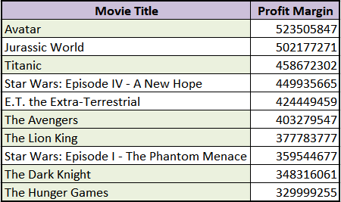

E. Budget Analysis: Analyze the correlation between movie budgets and gross earnings, and identify the movies with the highest profit margin.
For Correlation (Budget vs Gross), formula used =CORREL(C2:C3776, B2:B3776) where C2:C3776 is the Budget and B2:B3776 is the Gross till last row.
For Max Profit Margin, formula used =MAX(D2:D3776) where D2:D3776 is the Profit Margin and Profit Margin is calculated by B2 – C2 i.e., Gross – Budget.
For Movie with Max Profit, formula used =INDEX(A2:A3775, MATCH(MAX(D2:D3776), D2:D3776, 0)) where A2:A3776 is the Directors list till last row and D2:D3776 is the Profit Margin and 0 is the first exact match to the lookup value.

Slide 17
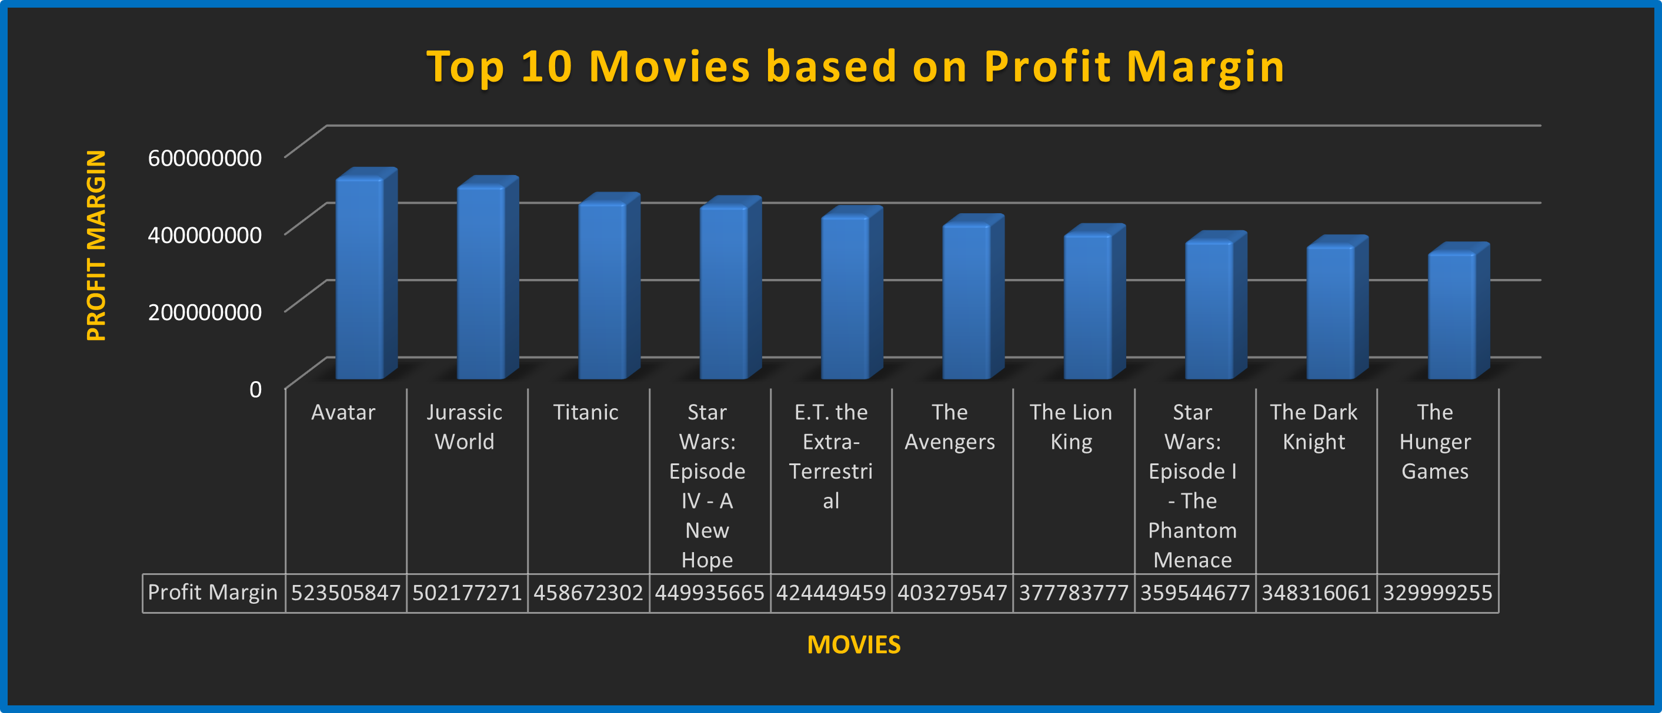
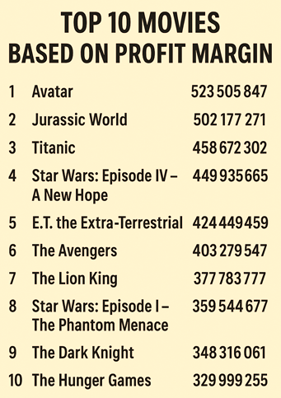
Highest Profit Margin: The profit margin of Avatar is about $523 million.
More Great Movies:
Jurassic World: $502 million
Titanic: $458 million
Star Wars: Episode IV - A New Hope: $449 million
E.T. the Extra-Terrestrial earned $449 million.
Middle Range:
The Avengers: $403 million
The Lion King: $377 million
Lower End:
Star Wars: Episode I - The Phantom Menace grossed $359 million.
The Dark Knight grossed $348 million.
The Hunger Games: $329 million

Slide 18
Results & Conclusion
The top 5 movie genres based on frequency are: Drama, Comedy, Action, Thriller and Romance and these genres dominate the movie landscape.
The average movie duration is 107 minutes and Median movie duration is100 minutes. The standard deviation in duration is 15 minutes, indicating most movies fall within a 90 to 120-minute range.
The top 5 languages most used in movies are: English, French, Spanish, Mandarin and Japanese in which English is the most prominent language in the global film industry.
The top 10 directors based on their average IMDB score are: Tony Kare, Charles Chaplin, Ron Fricke, Majid Majidi, Christopher Nolan, Damien Chazelle, Alfred Hitchcock, S.S. Rajamouli, Richard Marquand and Marius A. Markevicius and they are known for their ability to consistently produce high-quality films with strong ratings.
The top 5 movies based on profit margin are:
Avatar – Profit Margin: $523,505,847
Jurassic World – Profit Margin: $502,177,271
Titanic – Profit Margin: $458,672,302
Star Wars: Episode IV - A New Hope – Profit Margin: $449,935,665
E.T. the Extra-Terrestrial – Profit Margin: $424,449,459
These movies generated the highest returns relative to their production costs.
After Analyzing we conclude that Drama, Action and Comedy movies are the most widely watched genre, and English is the most preferred language for movies globally. Movies range from 90 to 120 minutes. Christopher Nolan and Charles Chaplin, Tony Kare are some of the top directors who produce best-rated movies. One must keep in mind here that enormous profits do not necessarily accompany enormous budgets—films like Star Wars and E.T. were box office successes with comparatively modest production budgets.

Slide 19


